Slide 1


A
PROJECT REPORT
ON
Hiding files without third-party software
SUBMITTED BY
BHAKTI DESAI – 53004190005
UNDER THE GUIDANCE OF
Prof. Sunita Gupta
DEPARTMENT OF MASTERS OF SCIENCE IN INFORMATION TECHNOLOGY
AT
SVKM’s
USHA PRAVIN GANDHI COLLEGE OF ARTS, SCIENCE AND COMMERCE
(NAAC ACCREDITED ‘A’ GRADE COLLEGE)
VILE PARLE (W), MUMBAI-400056
(AFFILIATED TO UNIVERSITY OF MUMBAI)
2020-21

Slide 2
Hiding files without third-party software.
Name : Bhakti Desai
Sap id : 53004190005
Guide : Prof. Sunita Gupta

Slide 3



ABSTRACT
Data has powered our biggest and most rewarding advancements and technologies over the last decade.
But there’s a real challenge with protecting consumer data privacy and preferences today.
Privacy is everything in today’s world.
Tired of maintaining multiple third-party applications for privacy of the entire file system.?
Want to manage all the private files without any interference of third-party agent?
This project feature’s in : Maintaining locks on the required secret/private files in Windows Operating System with just one click and without any third-party interference.

Slide 4

LIMITATIONS OF EXISTING SYSTEM
The use of private file services currently offered by online information-retrieval vendors and computer companies are not really safe.
After reviewing the nature of private file applications and users, we deal at some length with the question of costs—for storage and connect time, and for telecommunication.
Costs are compared for a standard case, based on one month's library usage of a private file on four different hosts: Data Star, IRS-ESA, Lockheed Dialog
There follows an account of the steps which one should take before implementing a private file in regard to record structure and format, as well as file loading and updating, and of the considerations involved in deciding whether or not to make use of a private file service

Slide 5

PROPOSED SYSTEM
Bring in transparency into the operations of the files and thus improve satisfaction of owners/admin of that file.
Reducing total costs and efforts being spent to manage privacy of the file by not using any third-party application/software.
Manage not using complex application/software with processes supported by tools, then being person independent.
Anybody with a basic knowledge of computer skills can work.
Even a novice can work on the this with initial assistance.
The main feature or the key idea of this project is giving users the privacy needed in low cost and with high efficiency without involving third-party application

Slide 6

acHIVEMENTS
Improved utilization of resources, efforts and costs. Because without third-party software, it considerably reduces the human efforts required for locking/hiding files.
Fast and accurate locking of files.
System is user friendly.
Eliminates the need of agent.
Systematic storage and easy access of data.
Adding, deleting and modifying the secret/private files are very easy.
Locking password can be modified without any third-party knowledge.

Slide 7

TECHNOLOGIES USED
A batch file is a script file in DOS, OS/2 and Microsoft Windows. It consists of a series of commands to be executed by the command-line interpreter, stored in a plain text file.
The term "batch" is from batch processing, meaning "non-interactive execution", though a batch file may not process a batch of multiple data.
A batch file may contain any command the interpreter accepts interactively and use constructs that enable conditional branching and looping within the batch file, such as IF, FOR, and GOTO labels.
The filename extension .bat is used in DOS and Windows. Windows NT and OS/2 also added .cmd. Batch files for other environments may have different extensions, e.g., .btm in 4DOS, 4OS2 and 4NT related shells.
A text editor is a type of computer program that edits plain text. Such programs are sometimes known as "notepad" software, following the naming of Microsoft Notepad.

Slide 8

How to create & run a batch (.bat) file ?
To create a basic batch (bat) file use this following steps :
Open Start
Search for notepad & click the top result to open the text editor.
Type the code lines in the text file to create a batch file.
Click the File menu and select the save as option.
Confirm a name for the script (eg., basic_batchfile.bat)
following are the steps to execute a batch file :
Open the command prompt (cmd.exe)
Go to the location where the .bat or .cmd file is stored.
Write the name of the file and press enter button to execute the batch file.

Slide 9
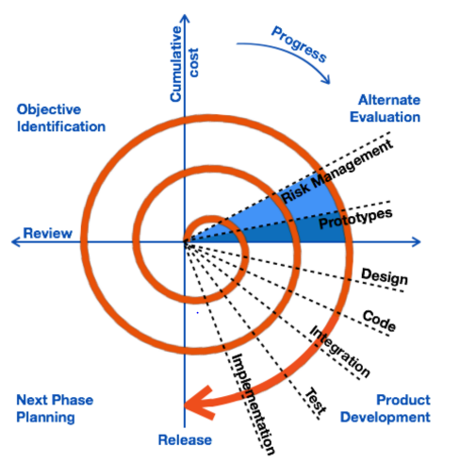
SOFTWARE MODEL USED
For the development of this project, I have decided to use Spiral Model -
Spiral model is a combination of both, iterative model and one of the SDLC model.
It can be seen as if you choose one SDLC model and combined it with cyclic process (iterative model).
This model considers risk, which often goes un-noticed by most other models.
The model starts with determining objectives and constraints of the software at the start of one iteration.
Next phase is of prototyping the software. This includes risk analysis.

Slide 10

SOFTWARE AND HARDWARE REQUIREMENTS
We are using computer hardware with Windows operating system.
We need a machine where you have text editor already installed.
There is no specific requirement of hardware and software.
We do not need to explicitly install or run any software/application.
Just a folder (which we want to lock) is required.

Slide 11
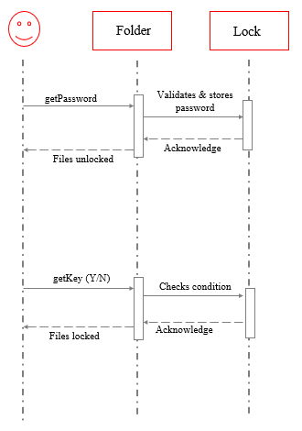
SEQUENCE DIAGRAM
A sequence diagram is a type of interaction diagram because it describes how and in what order a group of objects works together.
Here , for admin to unlock the folder, admin needs to provide the password if the password is correct, the folder will be unlocked.
To lock the folder again admin needs to double tap the file and enter a key (Y/N) according to the key value the folder actions will be decided.
If the key value is Y/y then the folder will be locked again. Otherwise, it will show wrong choice

Slide 12
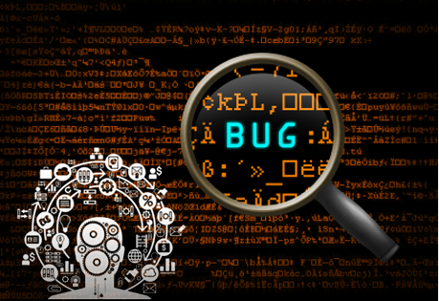
TESTING
To check whether the system is working neatly and error free. Four different types of testing are:
UNIT TESTING : Unit testing is very important in testing of the project, from the name itself, we come to know that it checks the system unit wise.
MODULE TESTING : The system is tested to check if all fields works together and produce as per the stated rules and regulations without affecting the tested during change. Each and every module is tested during programming stage.
INTEGRATED TESTING : All modules are integrated and combined to carry out module testing
SYSTEM TESTING : whole system is checked for whether the system is giving correct output as per the given expectation. It is the last stage therefore it is implemented for this a testing plan is necessary that will aid to maximize the effectiveness of discovering errors.

Slide 13

Future scope
Since this project is based for windows operating system.
In future, we can do the same locking system for other operating system also.
We can also provide proper GUI according to the requirements of Admin without affecting its complexity should not be increased.

Slide 14

Conclusion
This project defines the lock based secured hiding of files.
This project aims on the secrecy of private data files kept at the admin or domain machine.
This project also aims to reduce the costing and efforts needed for hiring third-party application to keep the private files secret.
By using this code block, it also reduces disk space as there is no need to install the application explicitly. Even a novice person can use this to keep the data private.
Transparency into the operations of the organization and thus improve satisfaction of admins/users is accomplished.
This project will help in managing private files from one place and in just one click.

Slide 15

References
https://scholar.google.co.in/scholar?hl=en&as_sdt=0,5&as_vis=1&qsp=8&q=comparative+review+private+files&qst=ir
https://www.tutorialspoint.com/batch_script/batch_script_files.hml
https://books.google.co.in/books?id=tFTMBQAAQBAJ&lpg=PA95&ots=F9kzJwSIIE&dq=research%20paper%20on%20encryption%20techniques&lr&pg=PA95#v=onepage&q=research%20paper%20on%20encryption%20techniques&f=false
https://link.springer.com/chapter/10.1007/978-981-10-4600-1_22
https://link.springer.com/chapter/10.1007/978-1-4757-0602-4_14

